Slide 1
Discussion Week 5

Slide 2
We will Discuss
What a thread is ?
Pthread example
Mutex example
Spin and lock example
Compare and swap example
Part 1
Part 2

Slide 3
What a Thread is?
Threads can be viewed as procedures that can run independently.
Threads duplicate only bare essential resources that enable them to run, hence making it lightweight.

Slide 4
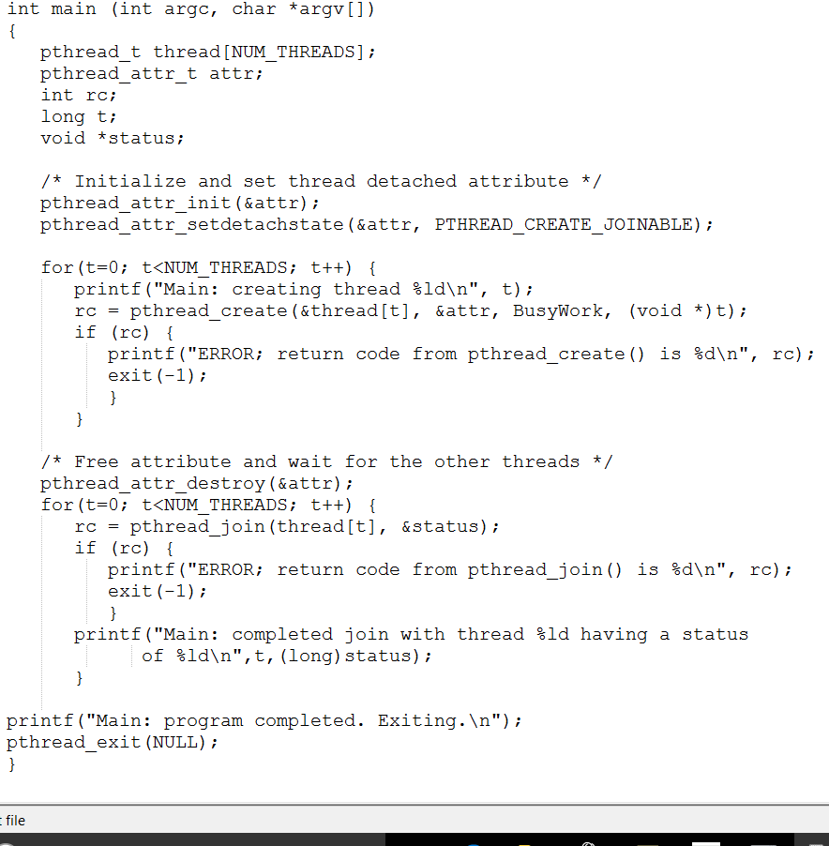
Pthread example

Slide 5
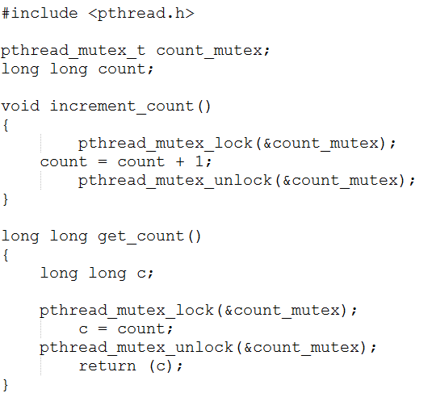
Mutex example

Slide 6
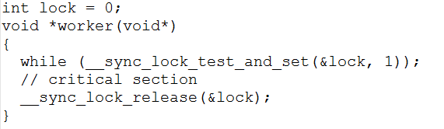
Spin and lock example

Slide 7
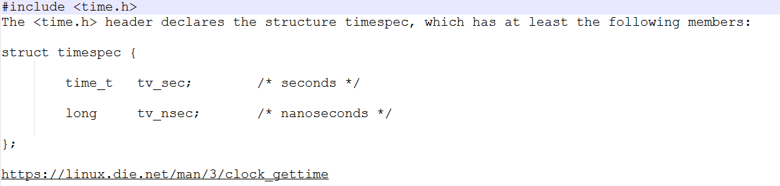
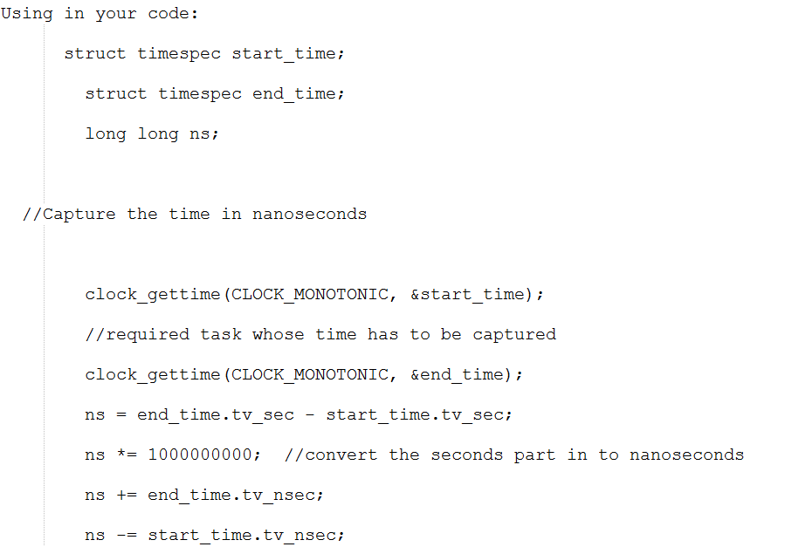

Slide 8
Compare and Swap
void cas_example(int *ptr, int val ) {
int old, new;
do {
old = *ptr;
new = old + val;
} while( __sync_val_compare_and_swap(ptr, old, new) != old);
}

Slide 9
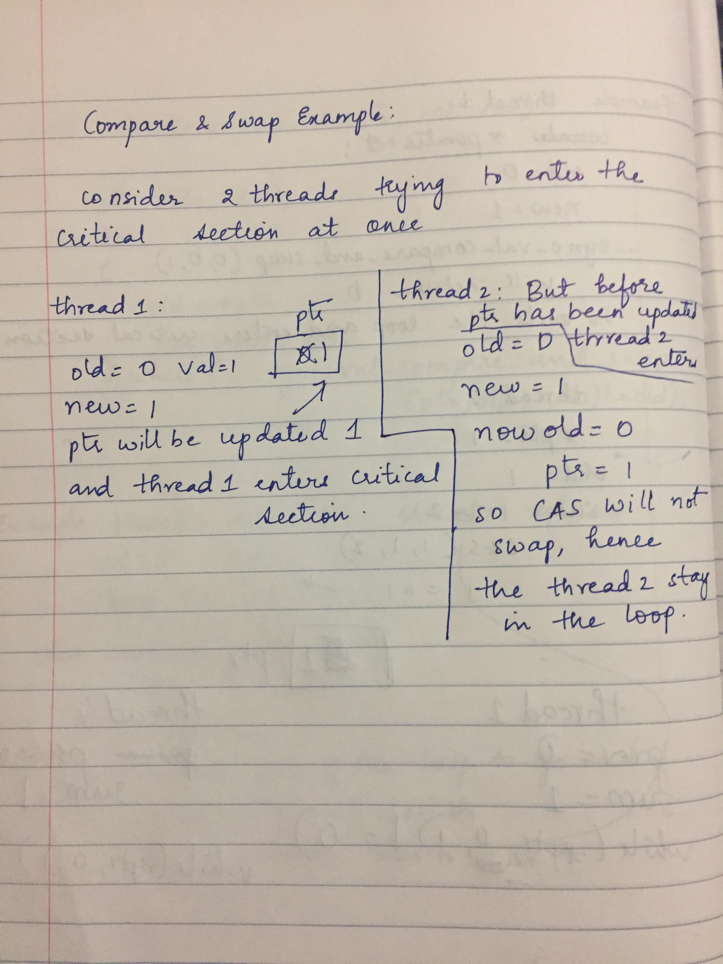

Slide 10
Part 1
Take user inputs.
Create the number of threads
Call the appropriate add function (for no. of iterations given)
Inside add function, in case user specifies synchronization, implement appropriate synchronization method specified.
Wait for all the threads to join.
Calculate the total time.
O/p the values and save them in a .csv file
Run the gnuplot script to generate graphs.

Slide 11
Part 2
To set appropriate bit in opt_yield according to the option specified (i or d or l) :
opt_yield|= INSERT_YIELD; (So, now opt_yield has 0x01)
From the spec:
in SortedList_insert if opt_yield & INSERT_YIELD
If(opt_yield & INSERT_YIELD)
//corresponding code
Same steps as part 1, except that you would be dealing with Doubly Linked lists.

